Slide 1

Created By :
Assistant Coordinator of
Basic Laboratorium

Slide 2
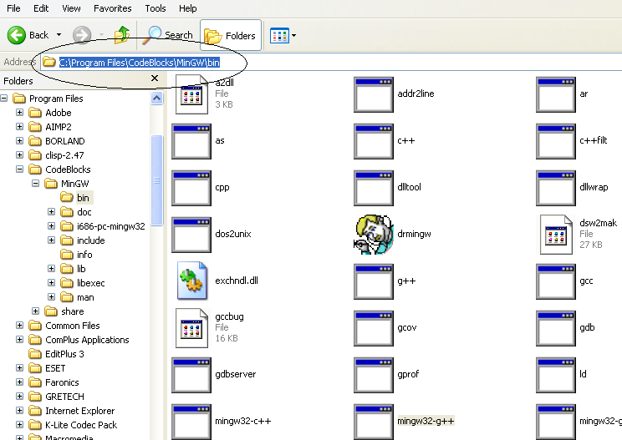
Step 1
Find gcc path in codeblock directory

Slide 3
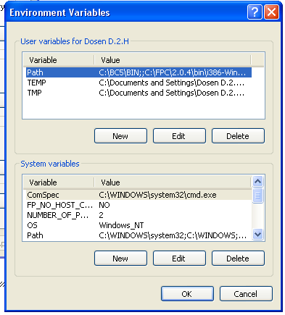
Step 2
Input gcc path in default windows variable path
Right-click my computer -> properties
Choose tab advanced
Choose Environment variables

Slide 4
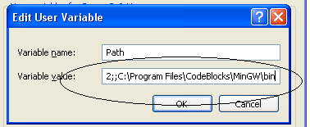
Step 3
add value of variable path with gcc path
Use double semicolon to separate (;;)
Example:
Xxxx;; C:\Program Files\CodeBlocks\MinGW\bin

Slide 5
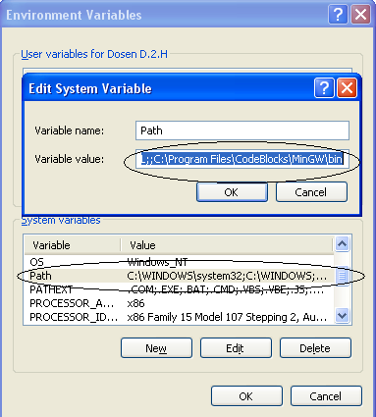
Step 4
Add value on system variable with path variable’s

Slide 6
Step 5
Finish

